Slide 1
Coles
Customer
Segmentation
BABY
Shiting (Angela) Yin
Cheng (Cassie) CHEN
Mohith Paul Kosh
Waleed Shafqat

Slide 2
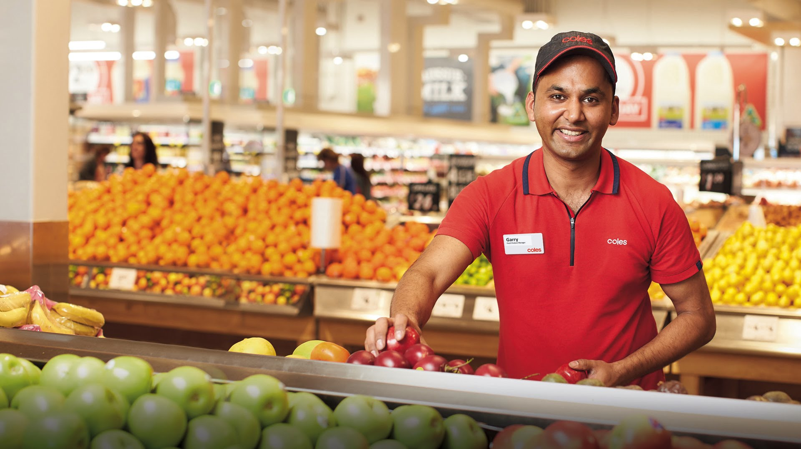

Overview
Introduction and Objectives
Segmentation Approach
Segments and Insights
Recommendation
Q&A

Slide 3
Introduction & Objective
BABY Products Customer Segmentation
Aim: Through customer segmentation analysis to develop customer profile with segments for Coles customers who have purchased baby products.
Objectives Breakdown:
Preprocess data and summarize data into an appropriate format
Build segmentation model by applying appropriate technique
Profile and segment customers based on different metrics
Generate insights from each customer segments
Validate model capability of scoring segments each week

Slide 4
Final Filtering Rules
PRODUCTS
Product Categories sold in at least 200 stores.
Our defined categories added to products
Remove Products with lows sales. Products which were among lowest 10% in sales amount as among lowest 10% in sales quantity
TRANSACTIONS
Transactional data of last 12 weeks.
Flybuys scanned transactions only

Slide 5
Final Filtering Rules
CUSTOMERS
Removed customers who visited Coles too many times in past 12 weeks (Top 0.1 Percentile)
Removed customers who visited Coles too few times in past 12 weeks (more than 2 visits in last 12 weeks)

Slide 6
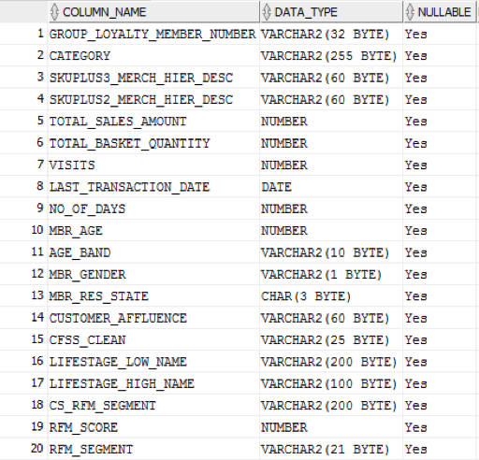
Final Table

Slide 7
Clustering
Clustering methods
K-Means Clustering : Simplicity & scalability
Appropriate for large datasets
Determining k value
Impact by initial random cluster center
Sensitive for outliers
Hierarchical Clustering : Implement easily
Interpret clearly, tree-based representation
Number of clusters unknown in result (cut)
Cost computation time

Slide 8
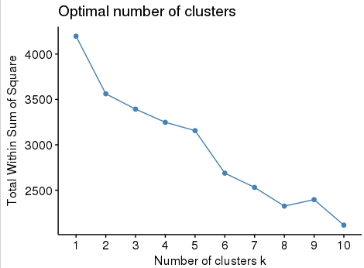
Clustering Analysis – Determine Clusters
how many clusters ???
Define k through experiences or visualization？
Objective way？
Elbow
Plot within-cluster sum of squared errors for each k in range that define before
The point that an “elbow” appears could be taken as the ideal value of K
Minimal one

Slide 9
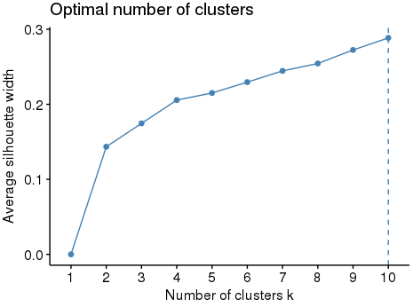
Clustering Analysis – Determine Clusters
how many clusters ???
Silhouette
Plot the average silhouette widths (difference between-cluster point)
The point with the highest average silhouette width could be taken as K

Slide 10
Clustering Analysis – Determine Clusters
how many clusters ???
Gap Statistic
Limitation of device
sophisticated
<time consumption>
Calculate total within intra-cluster variation under null reference distribution
The result with maximum could be taken as K (far away from uniform)
fviz_nbclust(baby_sample_10k, kmeans, method = "gap_stat", nstart = 25, nboot = 50)

Slide 11
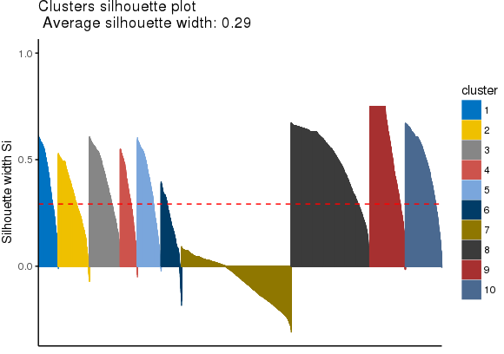
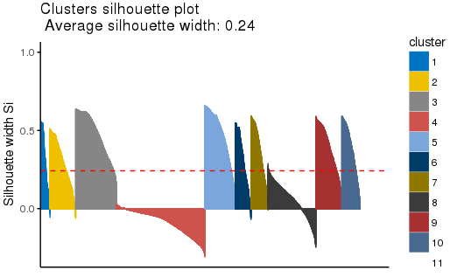
Silhouette plot
Positive widths === Good clustering
K = 10
K = 11
cluster11
Negative-sil-index 17%

Slide 12
Clustering Evaluation
Compactness (within-cluster cohesion ,small)
Separation (between clusters, large)
Cluster validation statistics
Average between -- separation
0.928137
Average within -- cohesion
0.6357427

Slide 13
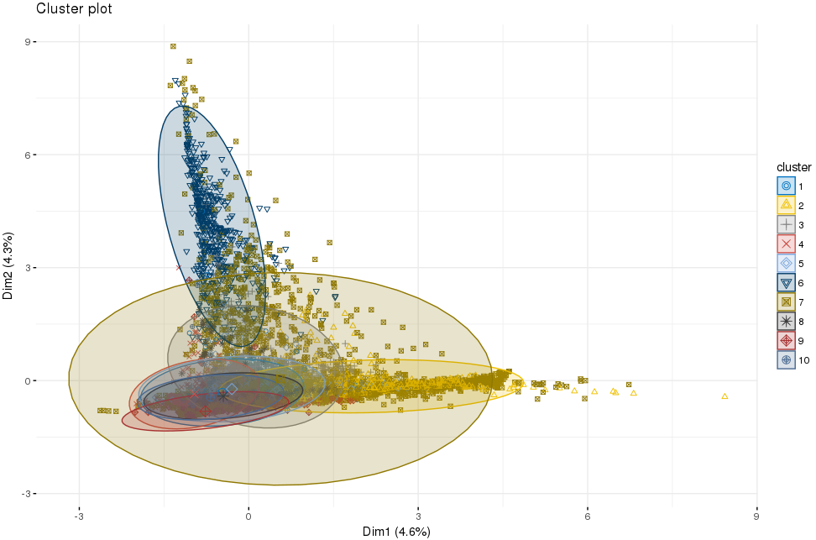
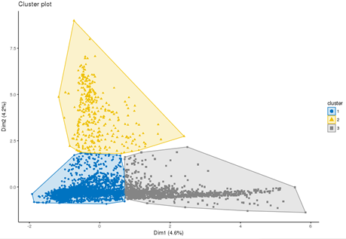
Clustering Analysis
Visualisation (high dimension VS two dimensions<account for 8.9% of variation>)
K-means results & original data
(principal components)
PCA
(first two principal components)

Slide 14
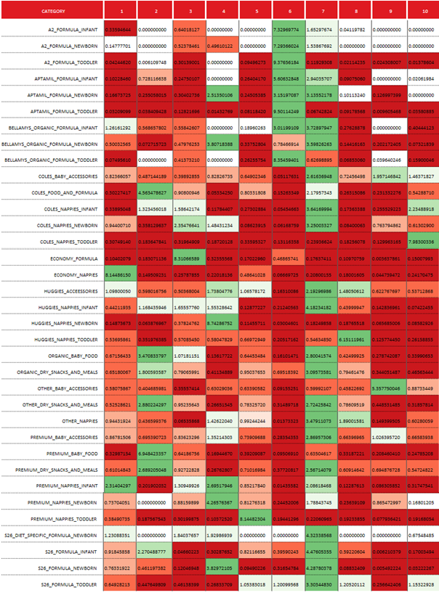
Clustering Analysis (sample)

Slide 15
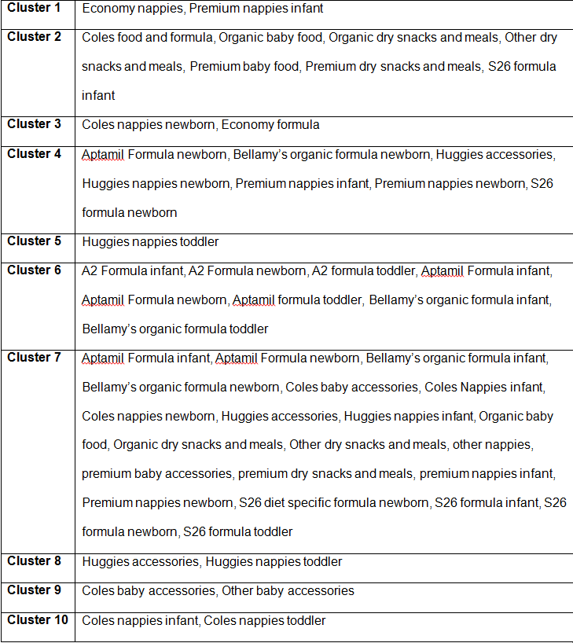
Clustering Analysis cont.

Slide 16
Scoring
Cluster statistics for 10k sample and whole population
Sample
Population

Slide 17
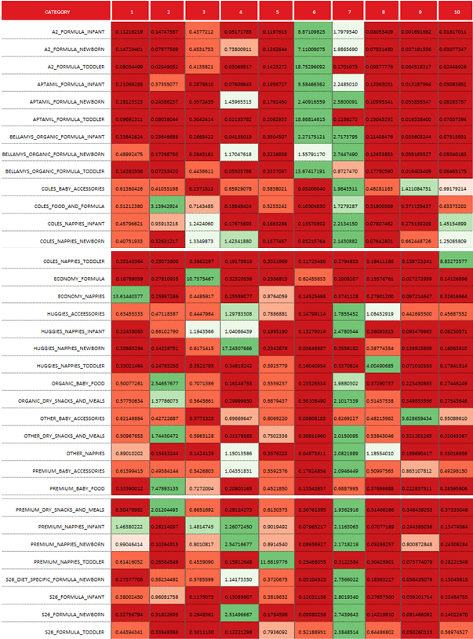
Scoring Analysis (population)

Slide 18
Profiling
Profiles clusters based on sales and customer features
Customer Features (demographics, geographies, spending behaviours):
Age
State
Gender
Affluence
Low Level Life Stage
CFSS
Coles RFM segments
Own-built RFM segments

Slide 19
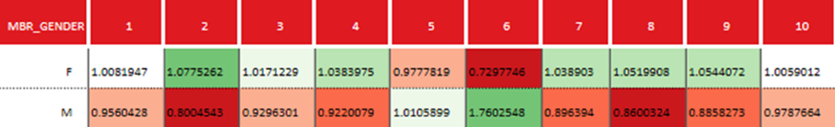
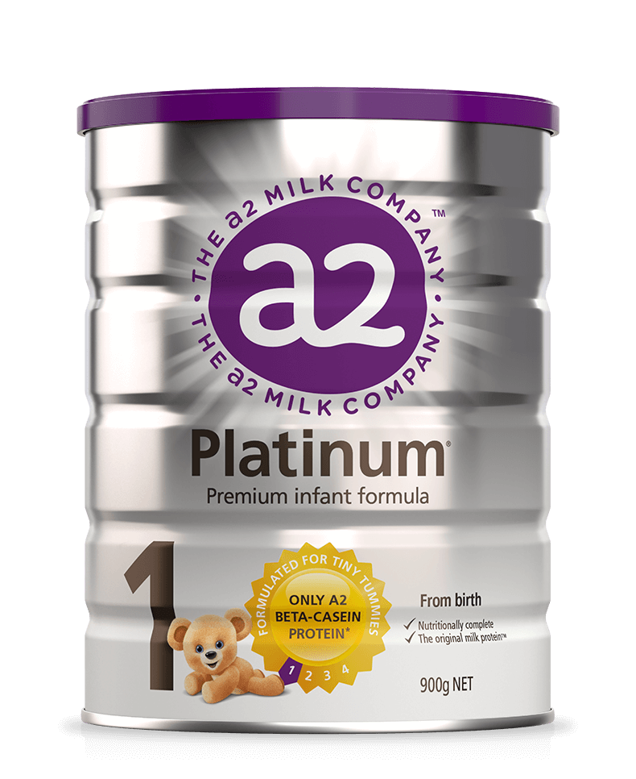
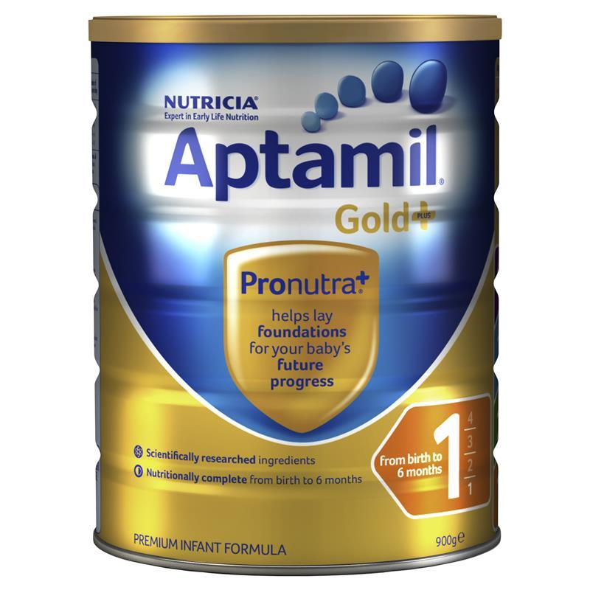
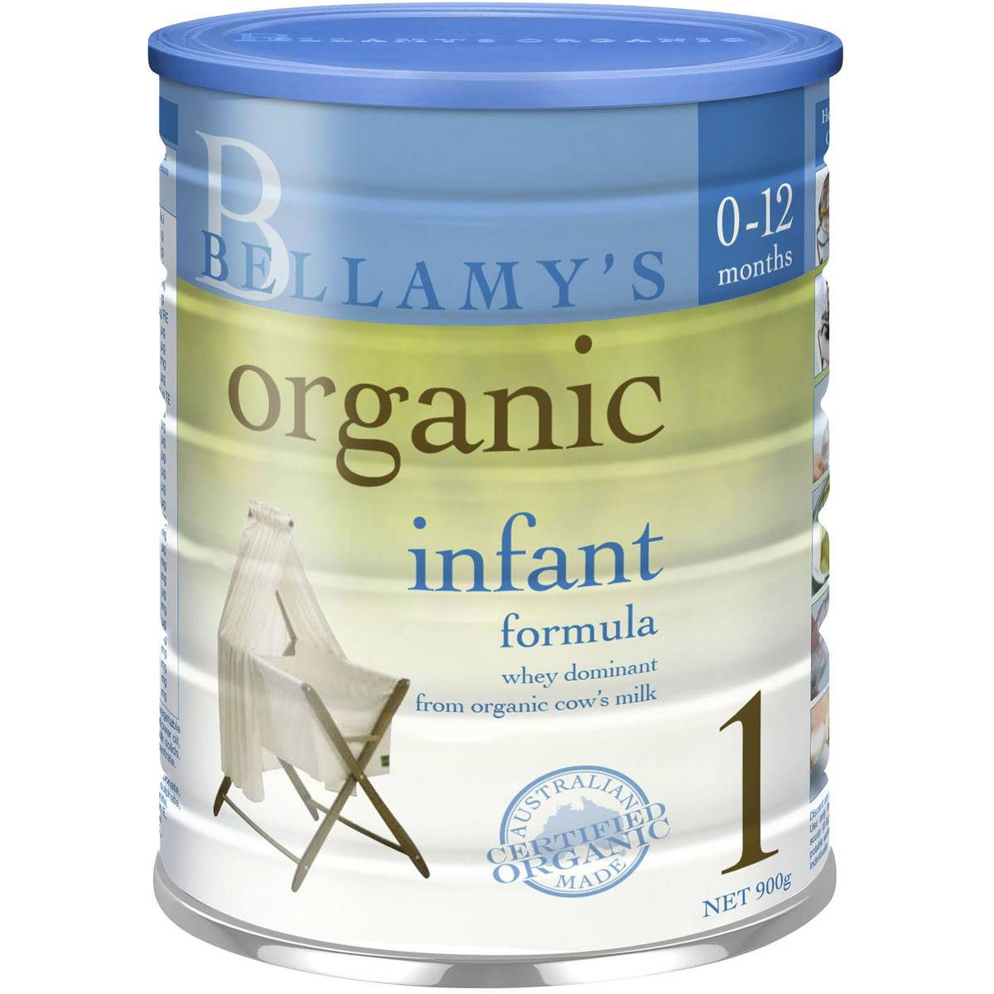
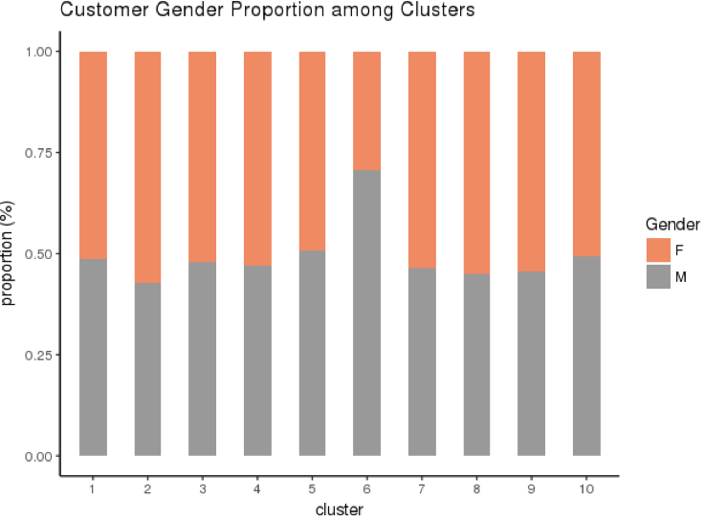
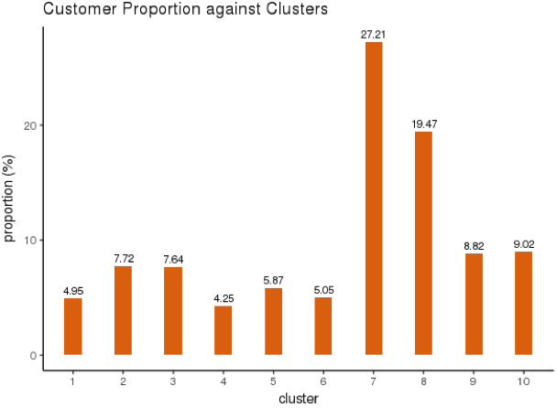

Profiling Indices Heatmap (e.g. Gender)
‘Male’ proportion with index of 1.76
5.05% of total customers
4% of total Sales

Slide 20
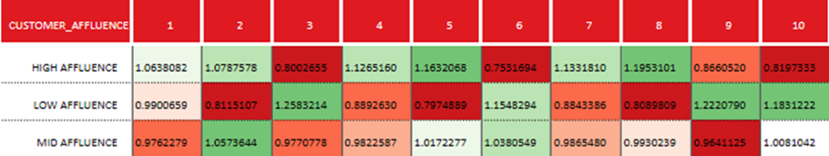
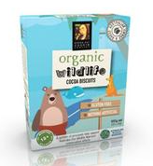
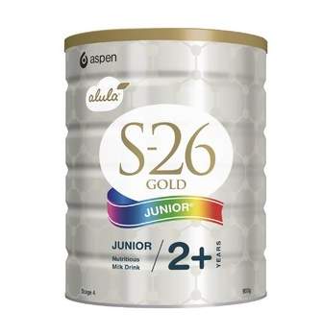
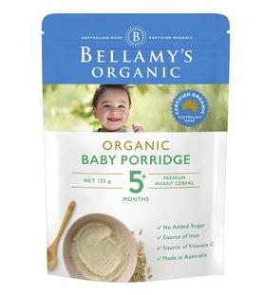
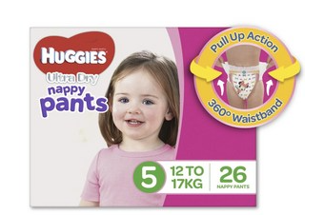
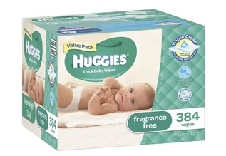
Profiling Indices Heatmap (e.g. Affluence)
High Affluence Cluster 7 - 27.21% customer proportion
Cluster 8 - 19.47% customer proportion
Low Affluence But they can buy premium formula. WHY?
Premium brand formula
Premium snacks and meals
Organic baby food
Huggies Nappies
Huggies Accessories

Slide 21
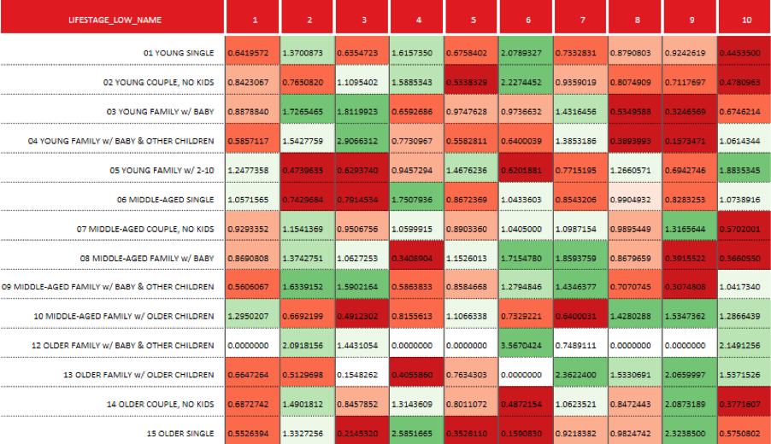
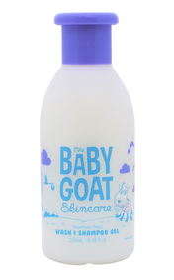
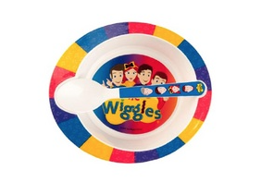
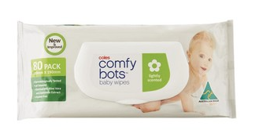
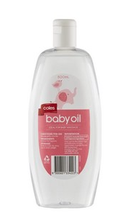
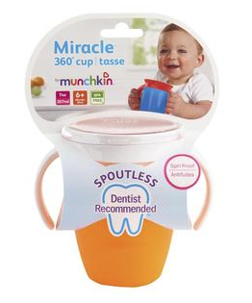
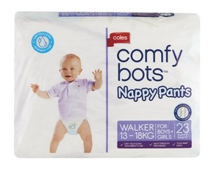
Profiling Indices Heatmap (e.g. Low Level Life Stage)
Young Single
Young Couple & no kids
Older Family
Middle-Age Family
Older Family

Slide 22
Profiling Overview

Slide 23
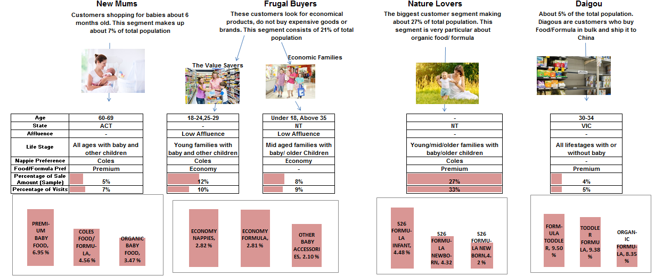
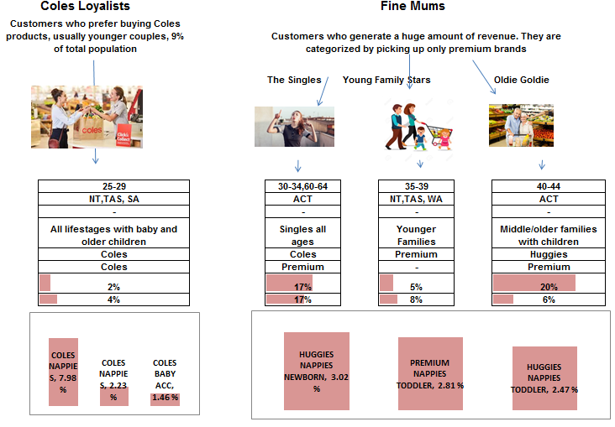
Customer Segmentation - Infographics
20-29, 60-69

Slide 24
Recommendations
Increase baby products sales, gain higher margins.
Build trusted-value position, enhance customer satisfaction
Strategy 1: Customization Communication
Rationale: Customizing communication with target customers enables to attain a closer relationship.
Tactics: (New Mums)
- Customization e-mails and promotion: Addressing names, Booklet of Parenting Newborns, Pop-up Top-Purchased Products

Slide 25
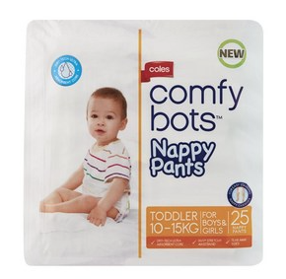
Recommendations
Strategy 2: Online Baby Product Sales
Rationale: Online channel is gaining across buyers all over the world and it is expected to rise at a higher pace over the forecast period
Tactics: Free Same-Day Delivery (Fine Mum); Direct Selling Worldwide (Daigou)
Strategy 3: Private Label Products
Rationale: Private label products imply lower prices for customers and higher margins for retailers
Tactics: New products development (Coles Loyalists)
– Coles Baby Food and Formula

Slide 26

Thank you!

